Slide 1
Recursion in C
Md. Alamgir Hossain
Senior Lecturer,
Dept. of CSE, Prime University
Mail: alamgir.cse14.just@gmail.com

Slide 2

Recursion in C
A function that calls itself is known as a recursive function. And, this technique is known as recursion.
While using recursion, programmers need to be careful to define an exit condition from the function, otherwise it will go into an infinite loop.
Recursive functions are very useful to solve many mathematical problems, such as calculating the factorial of a number, generating Fibonacci series, etc.

Slide 3
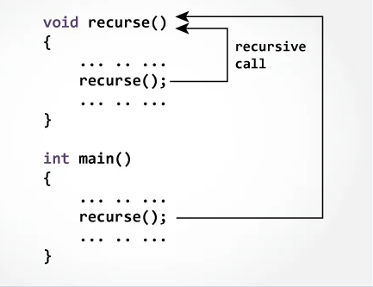
Working Process of Recursion

Slide 4
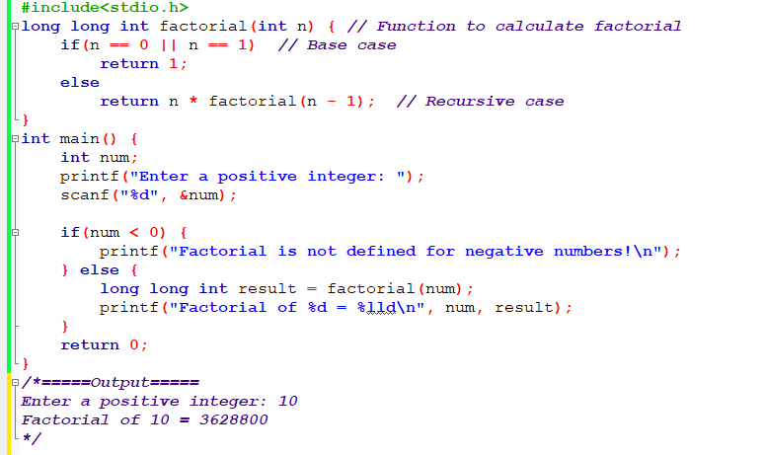
Factorial of a Number in C using Function

Slide 5
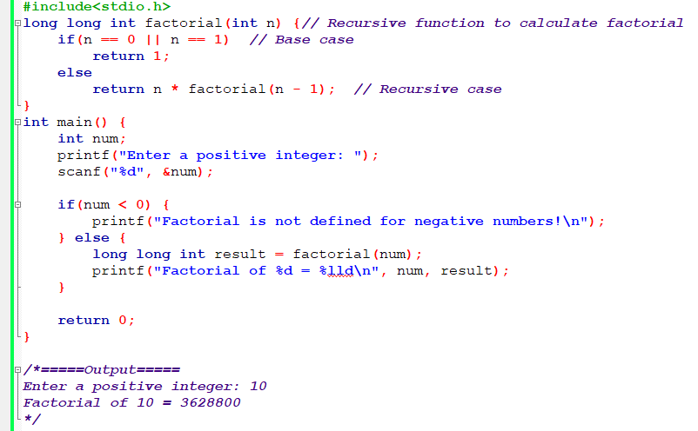
Factorial of a Number in C using Recursion

Slide 6
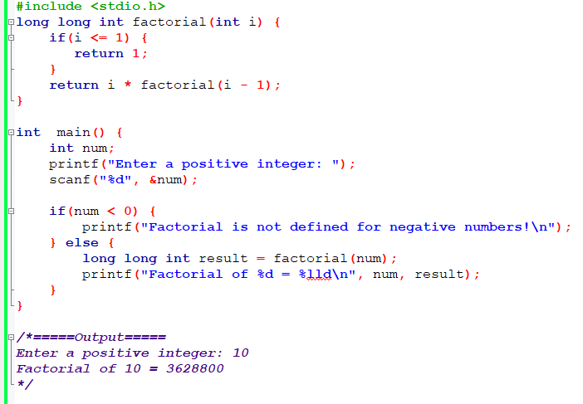
Changing the Base Case

Slide 7
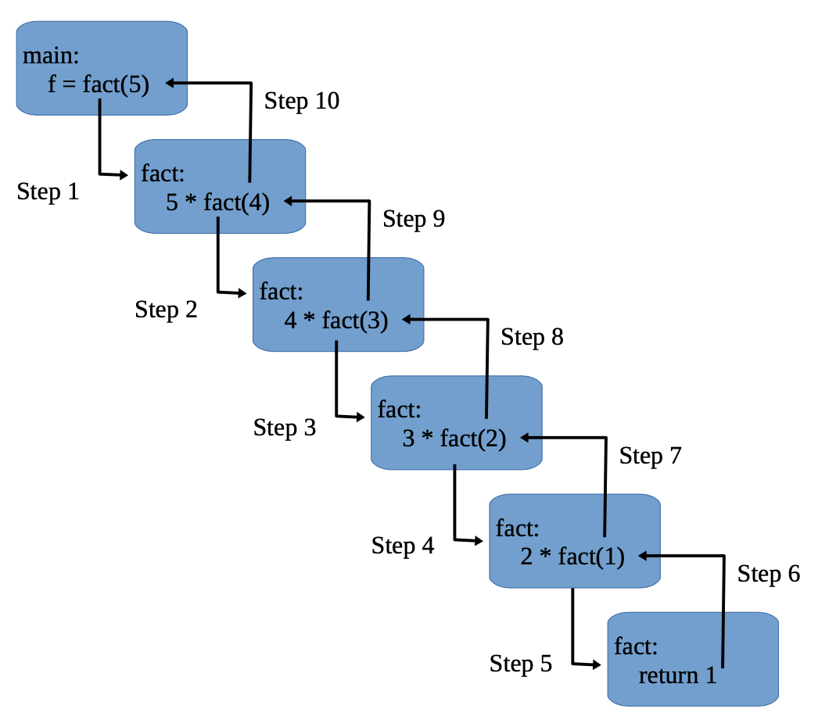
Factorial Calculating Process

Slide 8
Differences Between General Function & Recursion
Aspect | General Function | Recursion
Definition | A block of code designed to perform a particular task. | A programming technique where a function calls itself in its definition.
Purpose | Can perform any kind of task or operation depending on its implementation. | Used to solve problems that can be broken down into smaller, similar sub-problems.
Versatility | Highly versatile and can be used in numerous scenarios. | Primarily used for problems where the solution involves solving smaller instances of the same problem.
Parameters | Can accept various types and numbers of parameters. | Typically works with parameters that are modified in each recursive call.
Return Type | Can return any data type. | The return type depends on the problem, but it must be consistent across all recursive calls.
Control Flow | Can include various types of control flow structures such as loops, conditionals, etc. | Involves recursive calls, often coupled with conditional statements to define the base case.
Termination | Execution completes when the end of the function block is reached. | Requires a base case to prevent infinite recursion and stack overflow.
Memory Usage | Memory usage depends on the size of variables and data structures used in the function. | Each recursive call adds a new layer to the call stack, which can lead to high memory usage for deep recursion.
Usage Examples | Any standard function, such as calculating the sum of an array, finding the maximum value, etc. | Calculating factorial, Fibonacci sequence, binary search, etc.
Ease of Understanding | Generally straightforward, especially for simple tasks. | Can be more challenging to understand and debug, especially for complex recursion patterns.

Slide 9
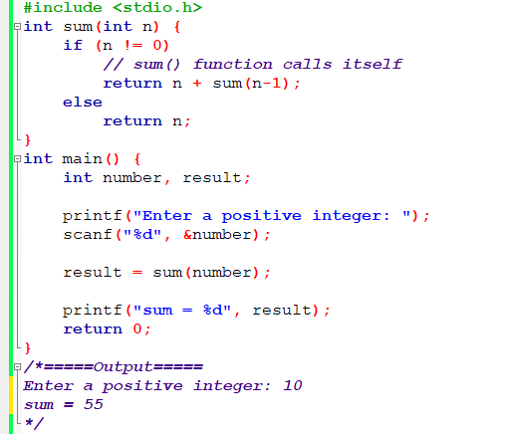
Sum of Natural Numbers Using Recursion

Slide 10
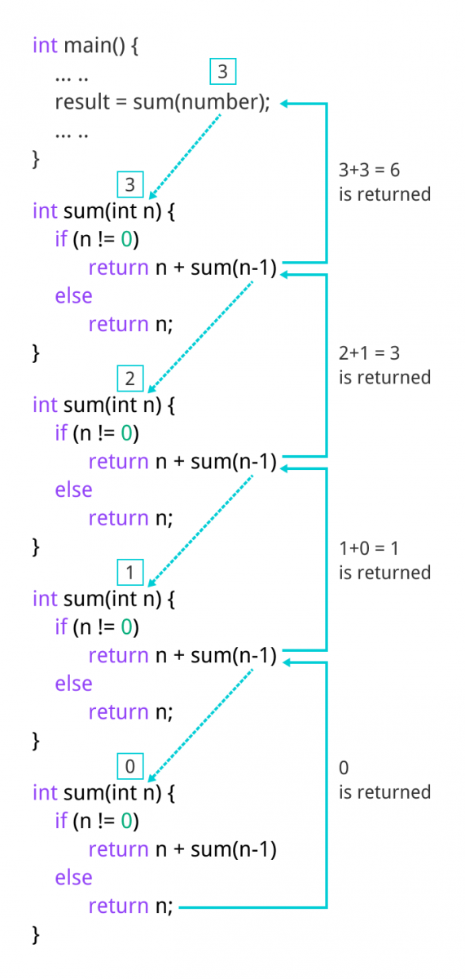

Slide 11
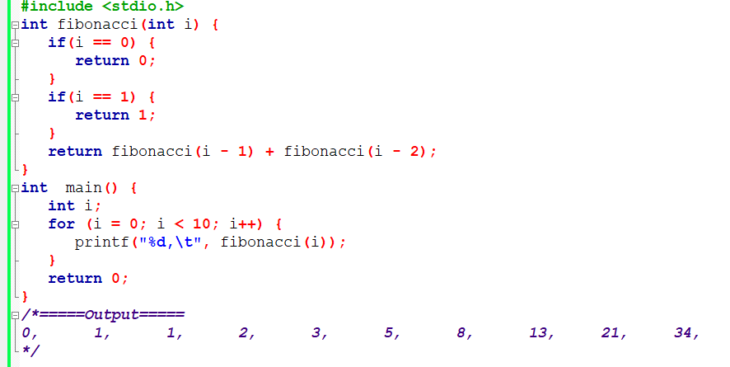
Fibonacci Series using Recursion

Slide 12
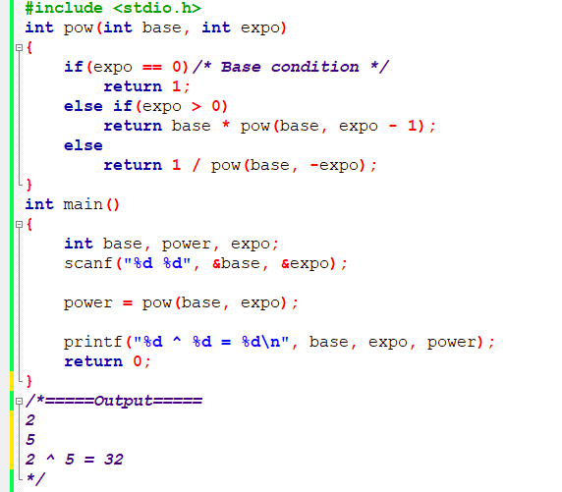
Power of a Number using Recursion

Slide 13
Homework
Write a C program to check a number palindrome or not using recursion.
Write a C program to find the sum of digits using recursion.
Write a C program to generate the nth Fibonacci term using recursion.
Write a C program to find HCF (GCD) using recursion.
Write a C program to find LCM using recursion.
Write C program to find sum of array elements using recursion.

Slide 14
Thank You

